Slide 1
Facial Analyzer for Rhinoplasty (Option 9)
Priscilla Carbo, Marvin Cazeau, Jared Curtis, Maree Kelly, Alessandra Oo

Slide 2

Table of Contents
Introduction
Design Constraints: Assumptions, dependencies, constraints
System Architecture: Diagrams, details
Sub-System Design: Overview, class diagram, interfaces
Lessons learned

Slide 3
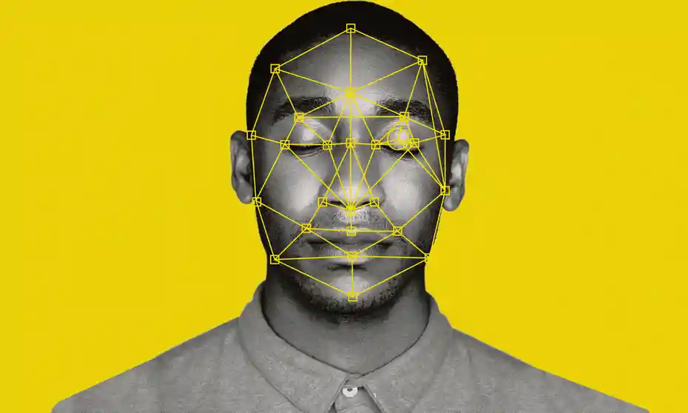
Introduction
Purpose
Help surgeons and patients who are getting a rhinoplasty surgery
Preview desired facial surgeries
ML algorithm
Main Goal
Database
CNN algorithm, the user is presented with a group of similarly proportioned faces
Use similarly proportioned faces to suggest changes to a patient’s nose
Future Plans
Growing database more for better accuracy
Alternative ways to integrate ML
User interface
Notes:
Our main goals for our team was the CNN algorithm. That is what we spent the most time on. Also we scanned 98 new faces into our database

Slide 4

Benefits / Importance
Provides patients with the opportunity to see the changes before the surgery.
Assists Plastic surgeons by making surgery easier and more accurate
Presents patients with multiple applicable options to choose from.
Enhances the overall practice of Plastic surgery, benefiting hospitals that provide that service
Potential applications for other reconstructive surgery.

Slide 5

Design Constraints
The Blender Software
Digitized Rhinoplasty Web Application
iOS device with iOS 11.01 or later with TrueDepth camera working
Bellus3D iOS Application
Python
Dependencies

Slide 6

Design Constraints
Clients would submit photo without face masks, facial tattoos, makeup, facial piercings and glasses
Assumptions

Slide 7

Design Constraints
Bellus3D application will discontinue
Only an iOS device is able to use Bellus3D application
Initial points can only be generated on Digitized Rhinoplasty website (manually)
General Constraints

Slide 8
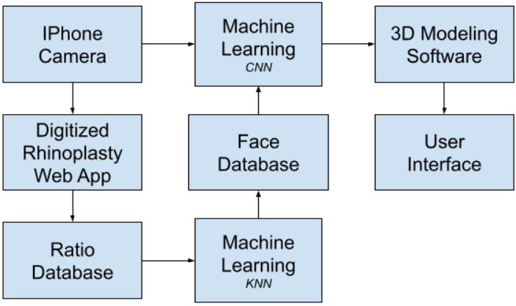
System Architecture: Class Diagram
Notable Files
read_in.py
match_faces.py
sorter.py
match_faces_CNN.py
generate_new_points.py
NovaIntia2.blend / NovaIntiav2.py

Slide 9

Database of Ratios

Slide 10
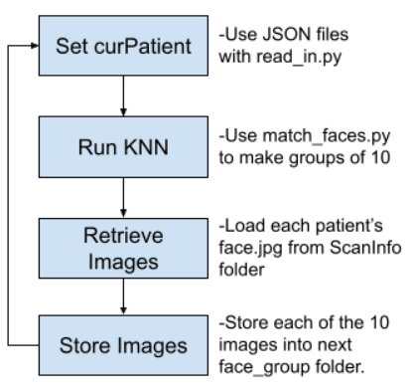
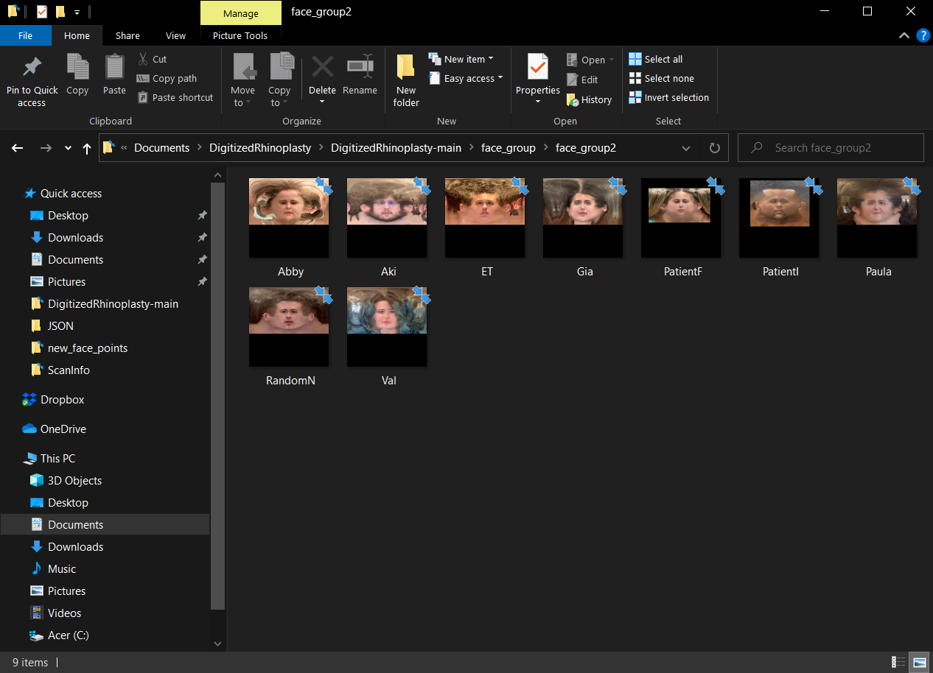
System Architecture: Face Database
Interested in how this works? Watch a video explaining the process here: https://github.com/jcurtis664/FacialAnalyzer/blob/main/Deliverables/videos/sort_using_knn.mp4

Slide 11
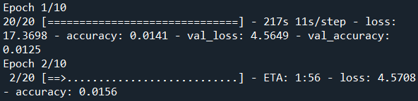
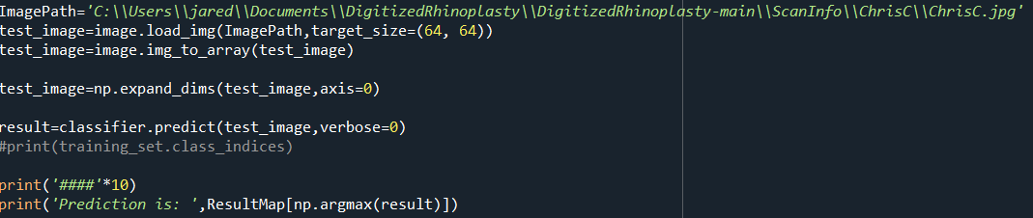
System Architecture: CNN Implementation

Slide 12
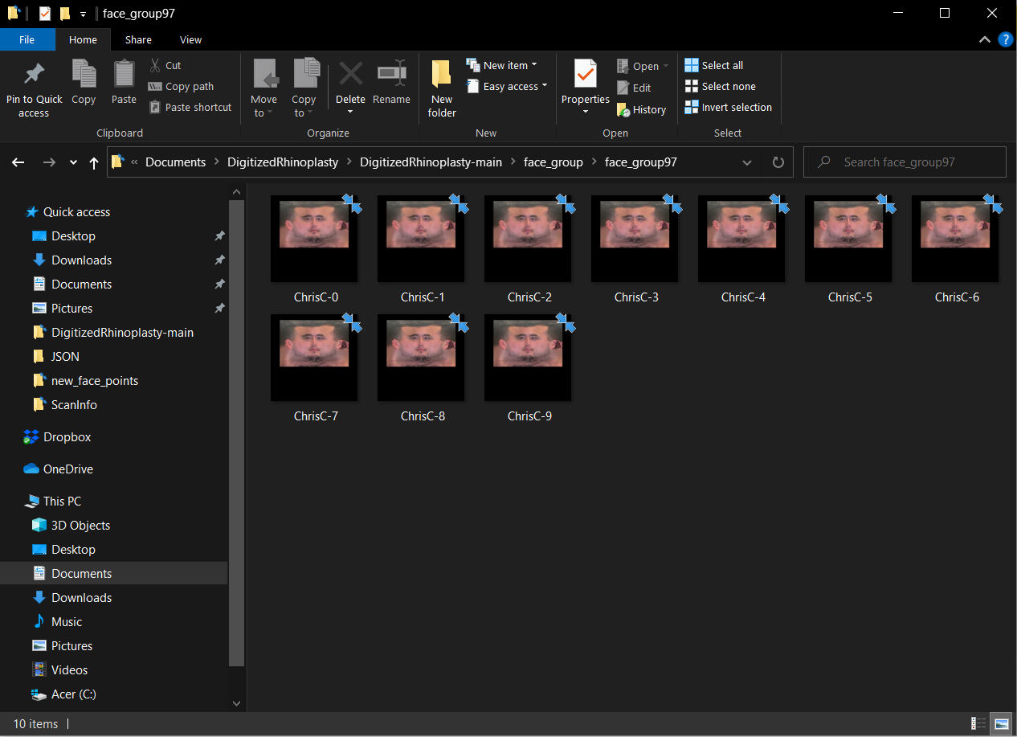
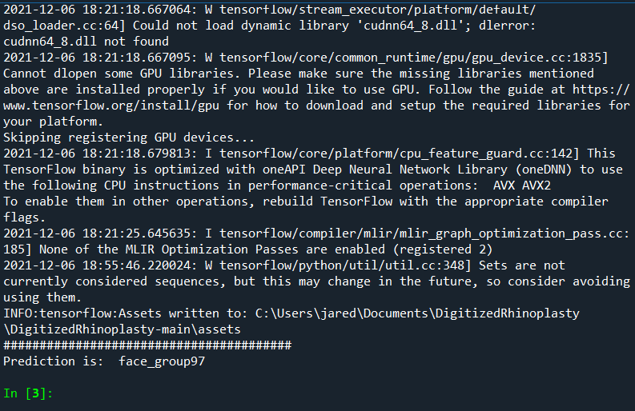
System Architecture: CNN Implementation

Slide 13
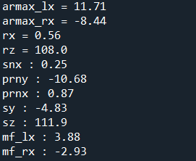
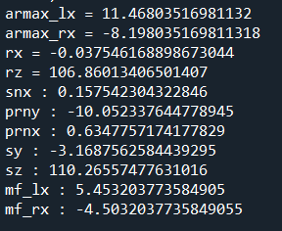
System Architecture: New Point Generation

Slide 14
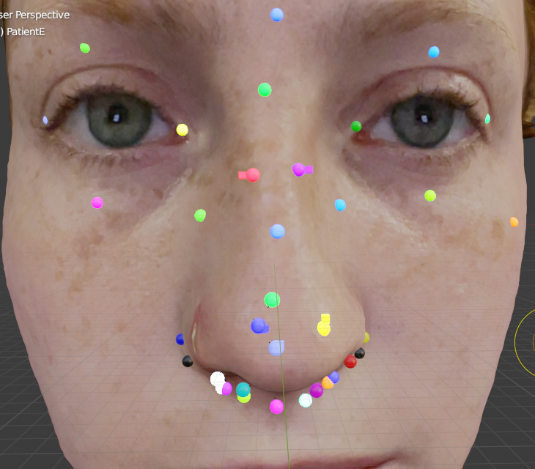
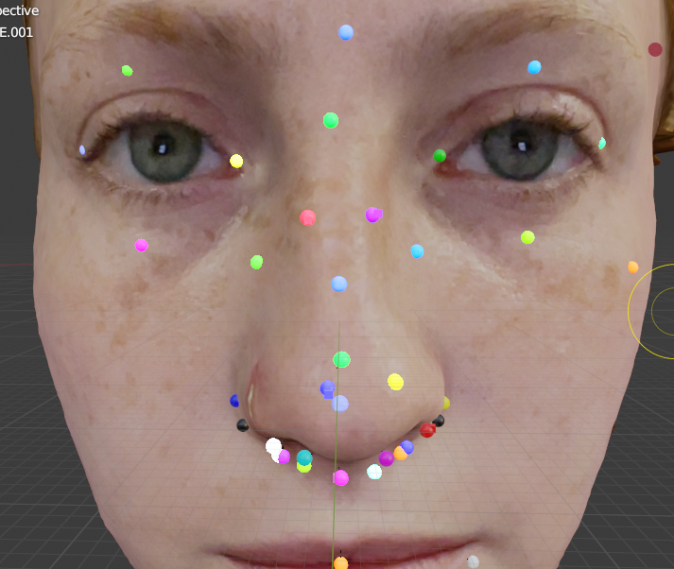
System Architecture: New Point Generation

Slide 15
System Architecture: New Point Generation

Slide 16
Future Plans
Utilize more accurate ratios
Suggest changes to all nose landmarks
Classify patients by gender and ethnicity for CNN training
Machine Learning

Slide 17
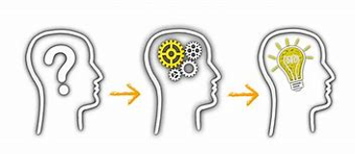
Lessons Learned
Time management
Planning
There’s a multitude of different ways to implement the ML
Scarcity of data
It costs $1 export the .obj, .mtl and jpeg formatted files for each face

Slide 18

Project timeline
Sprint 1
Previous team’s work
Researching different ML algorithms
Sprint 2
Previous team’s work
CNN algorithm implementation
Scanning faces
Sprint 3
Scanning faces
Growing database
CNN algorithm implementation

Slide 19

Questions?

Slide 20
Thank you

